Slide 1
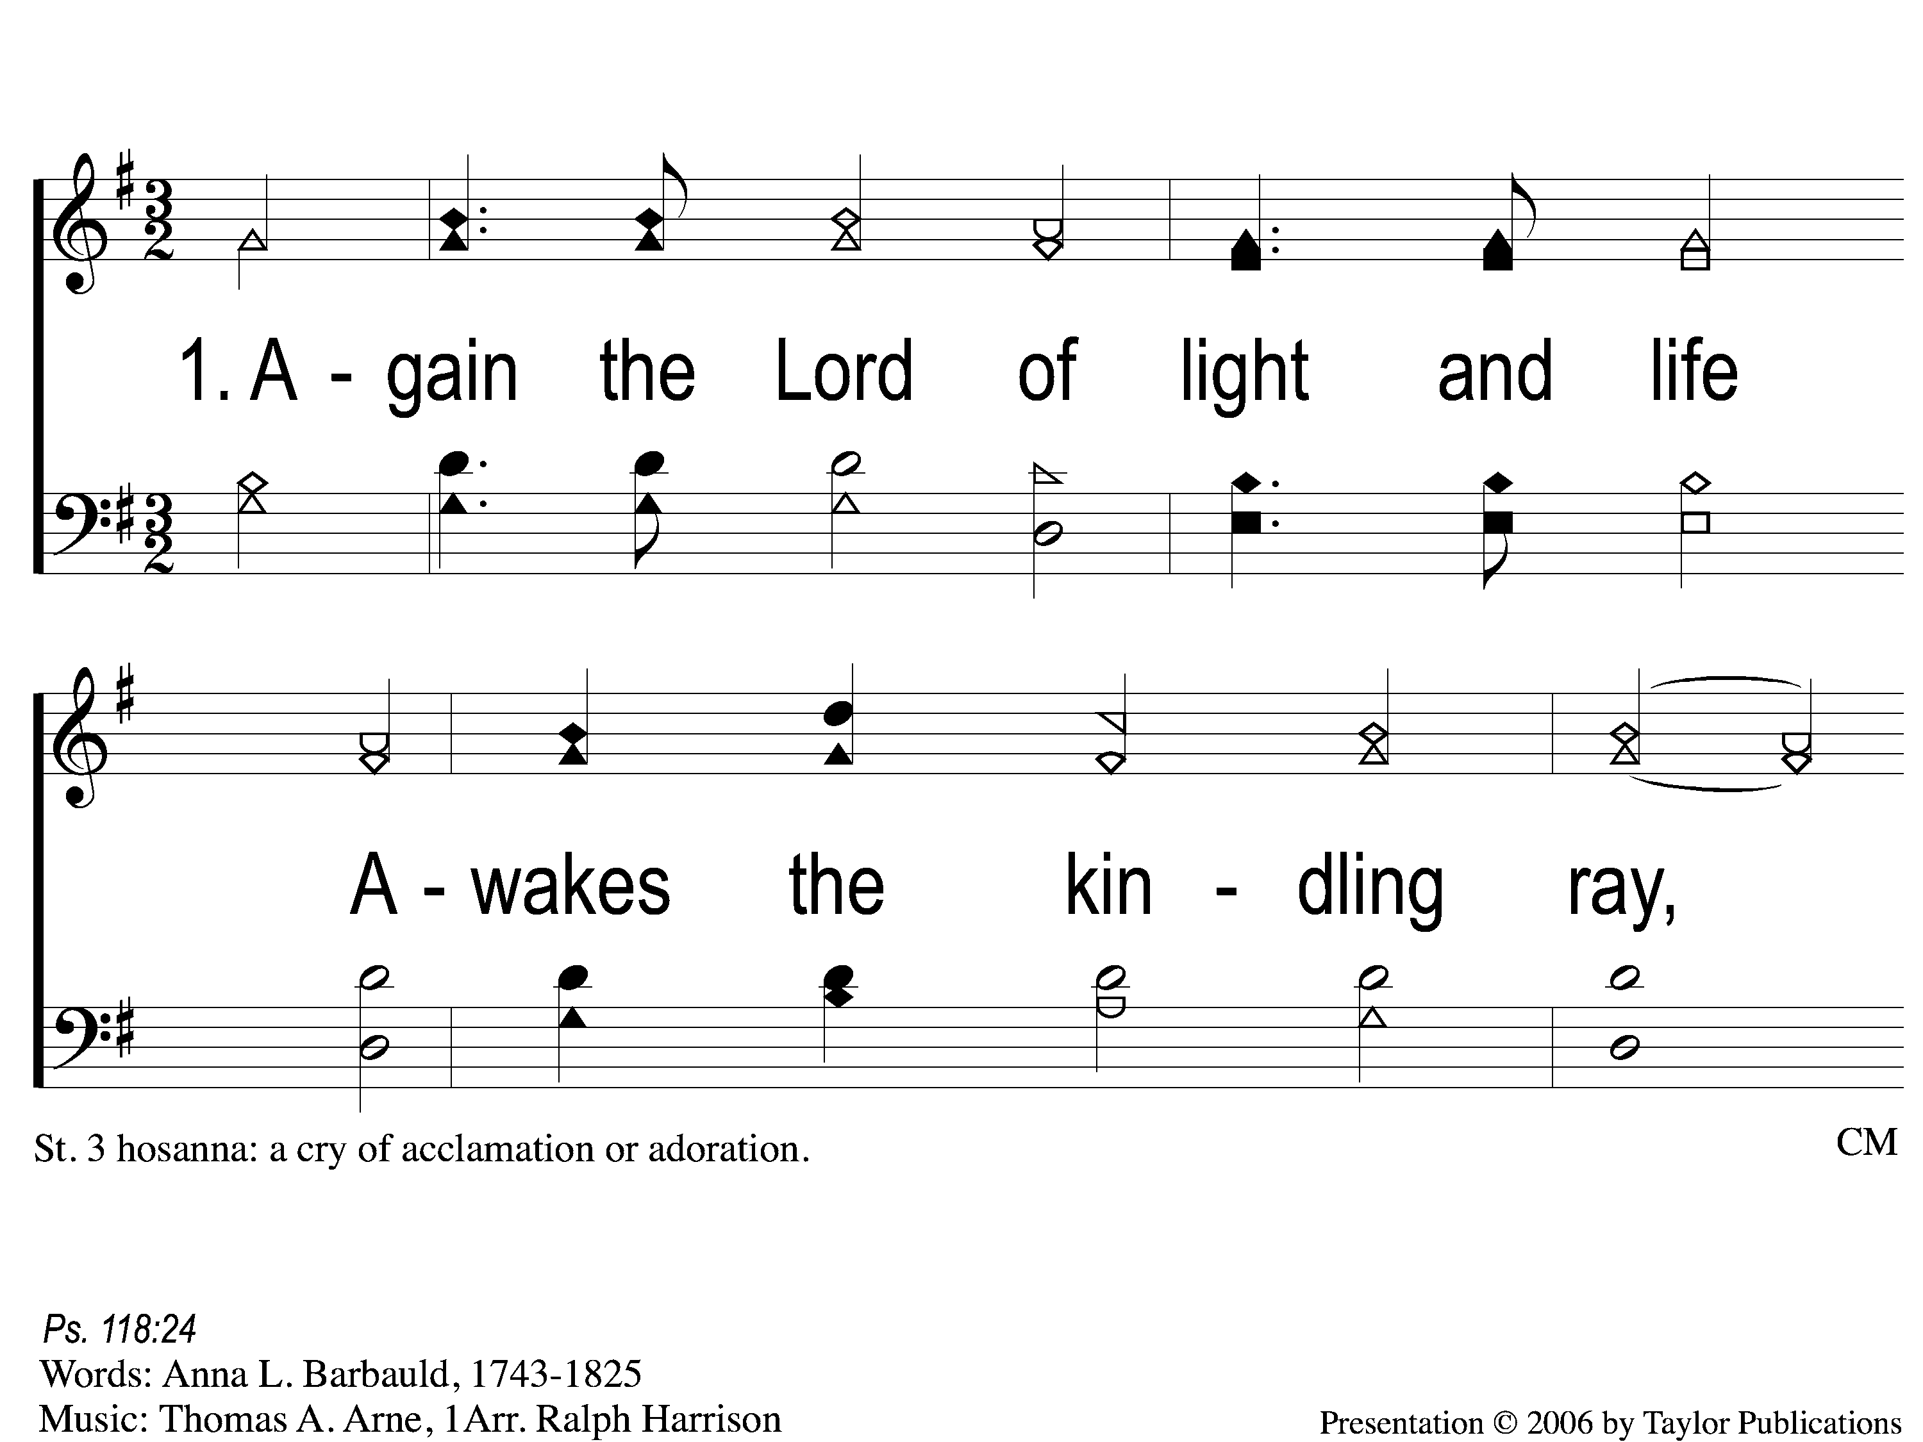
1-1 Again the Lord of Light and Light
Again the Lord of Light and Life
20

Slide 2
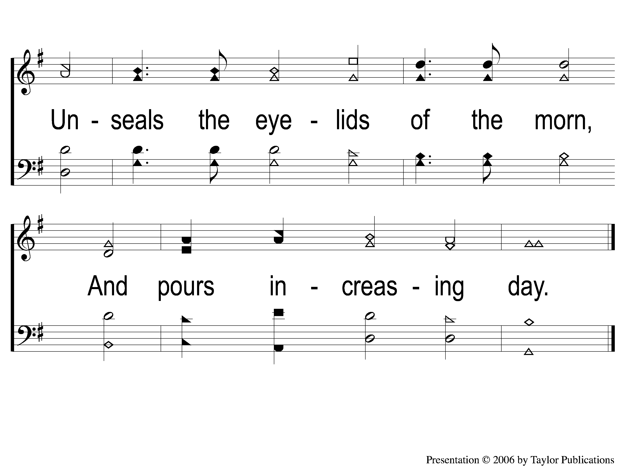
1-2 Again the Lord of Light and Light
Again the Lord of Light and Life
20

Slide 3
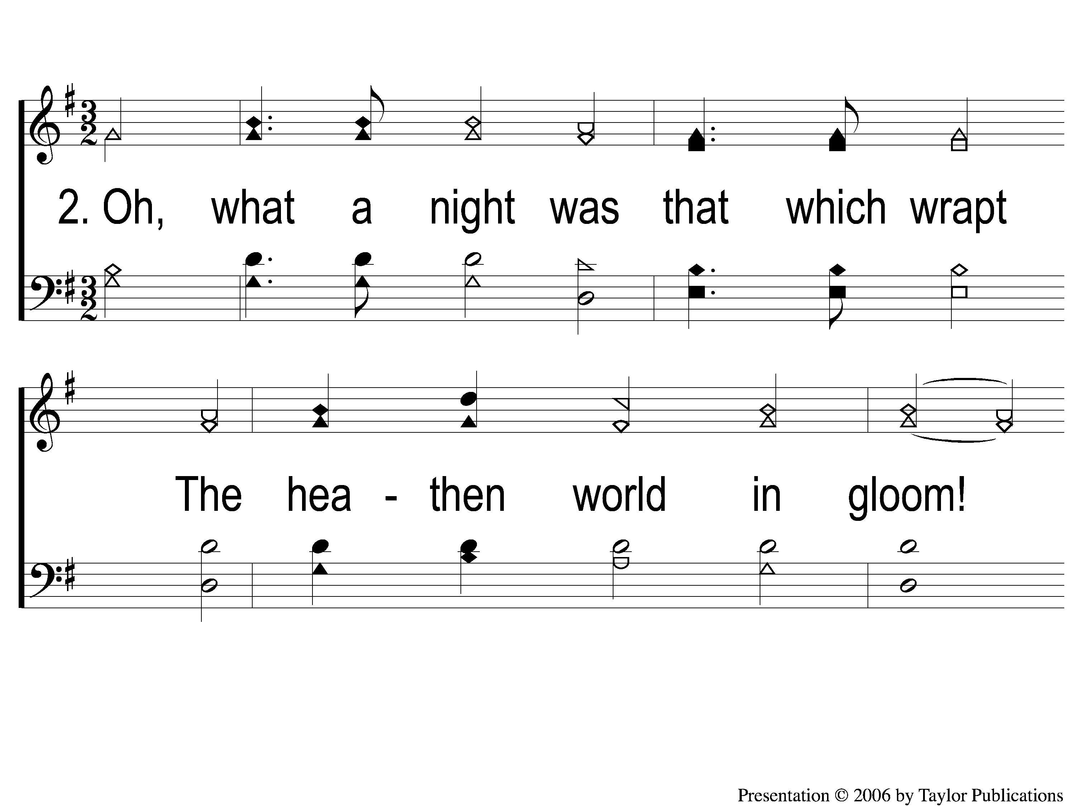
2-1 Again the Lord of Light and Light
Again the Lord of Light and Life
20

Slide 4
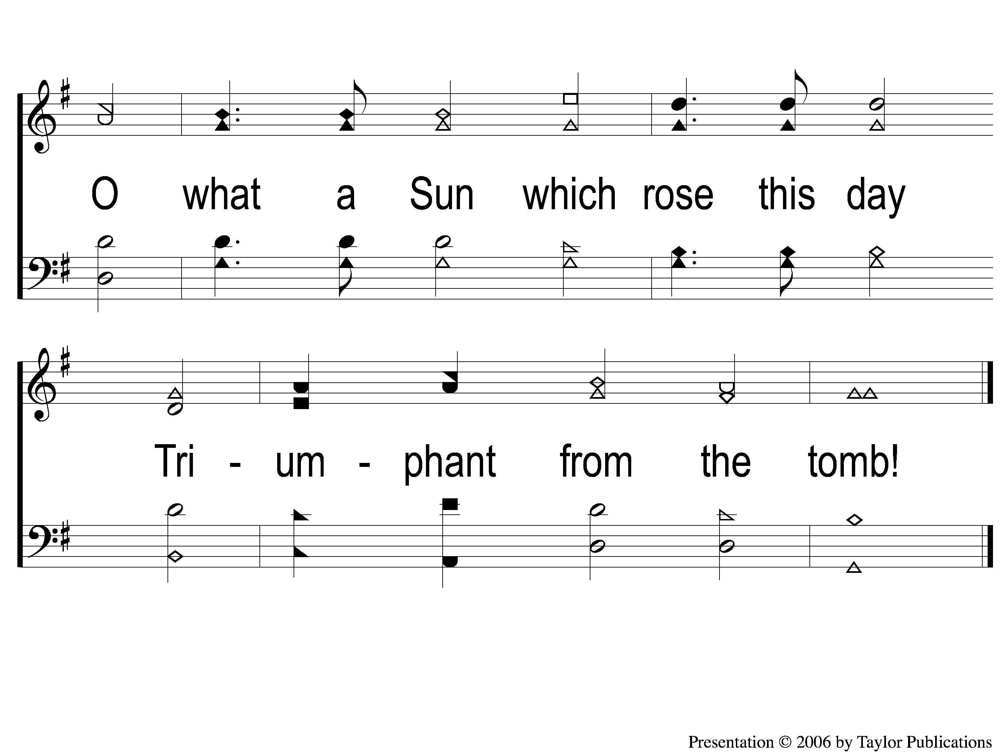
2-2 Again the Lord of Light and Light
Again the Lord of Light and Life
20

Slide 5
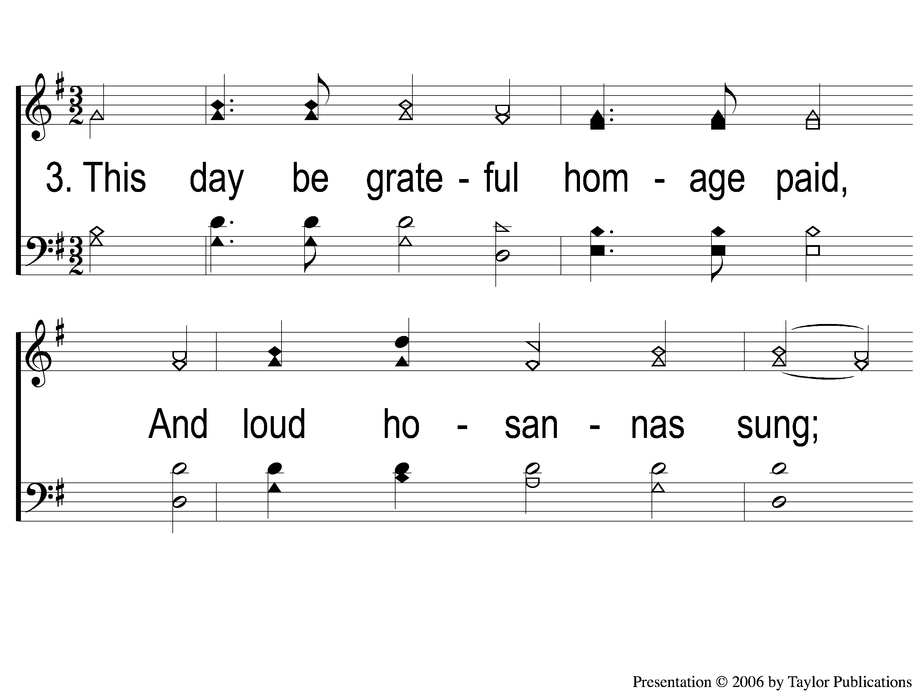
3-1 Again the Lord of Light and Light
Again the Lord of Light and Life
20

Slide 6
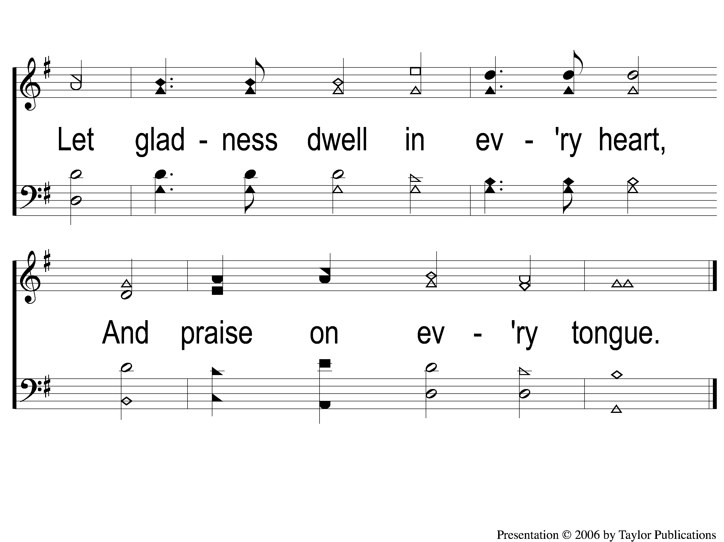
3-2 Again the Lord of Light and Light
Again the Lord of Light and Life
20

Slide 7
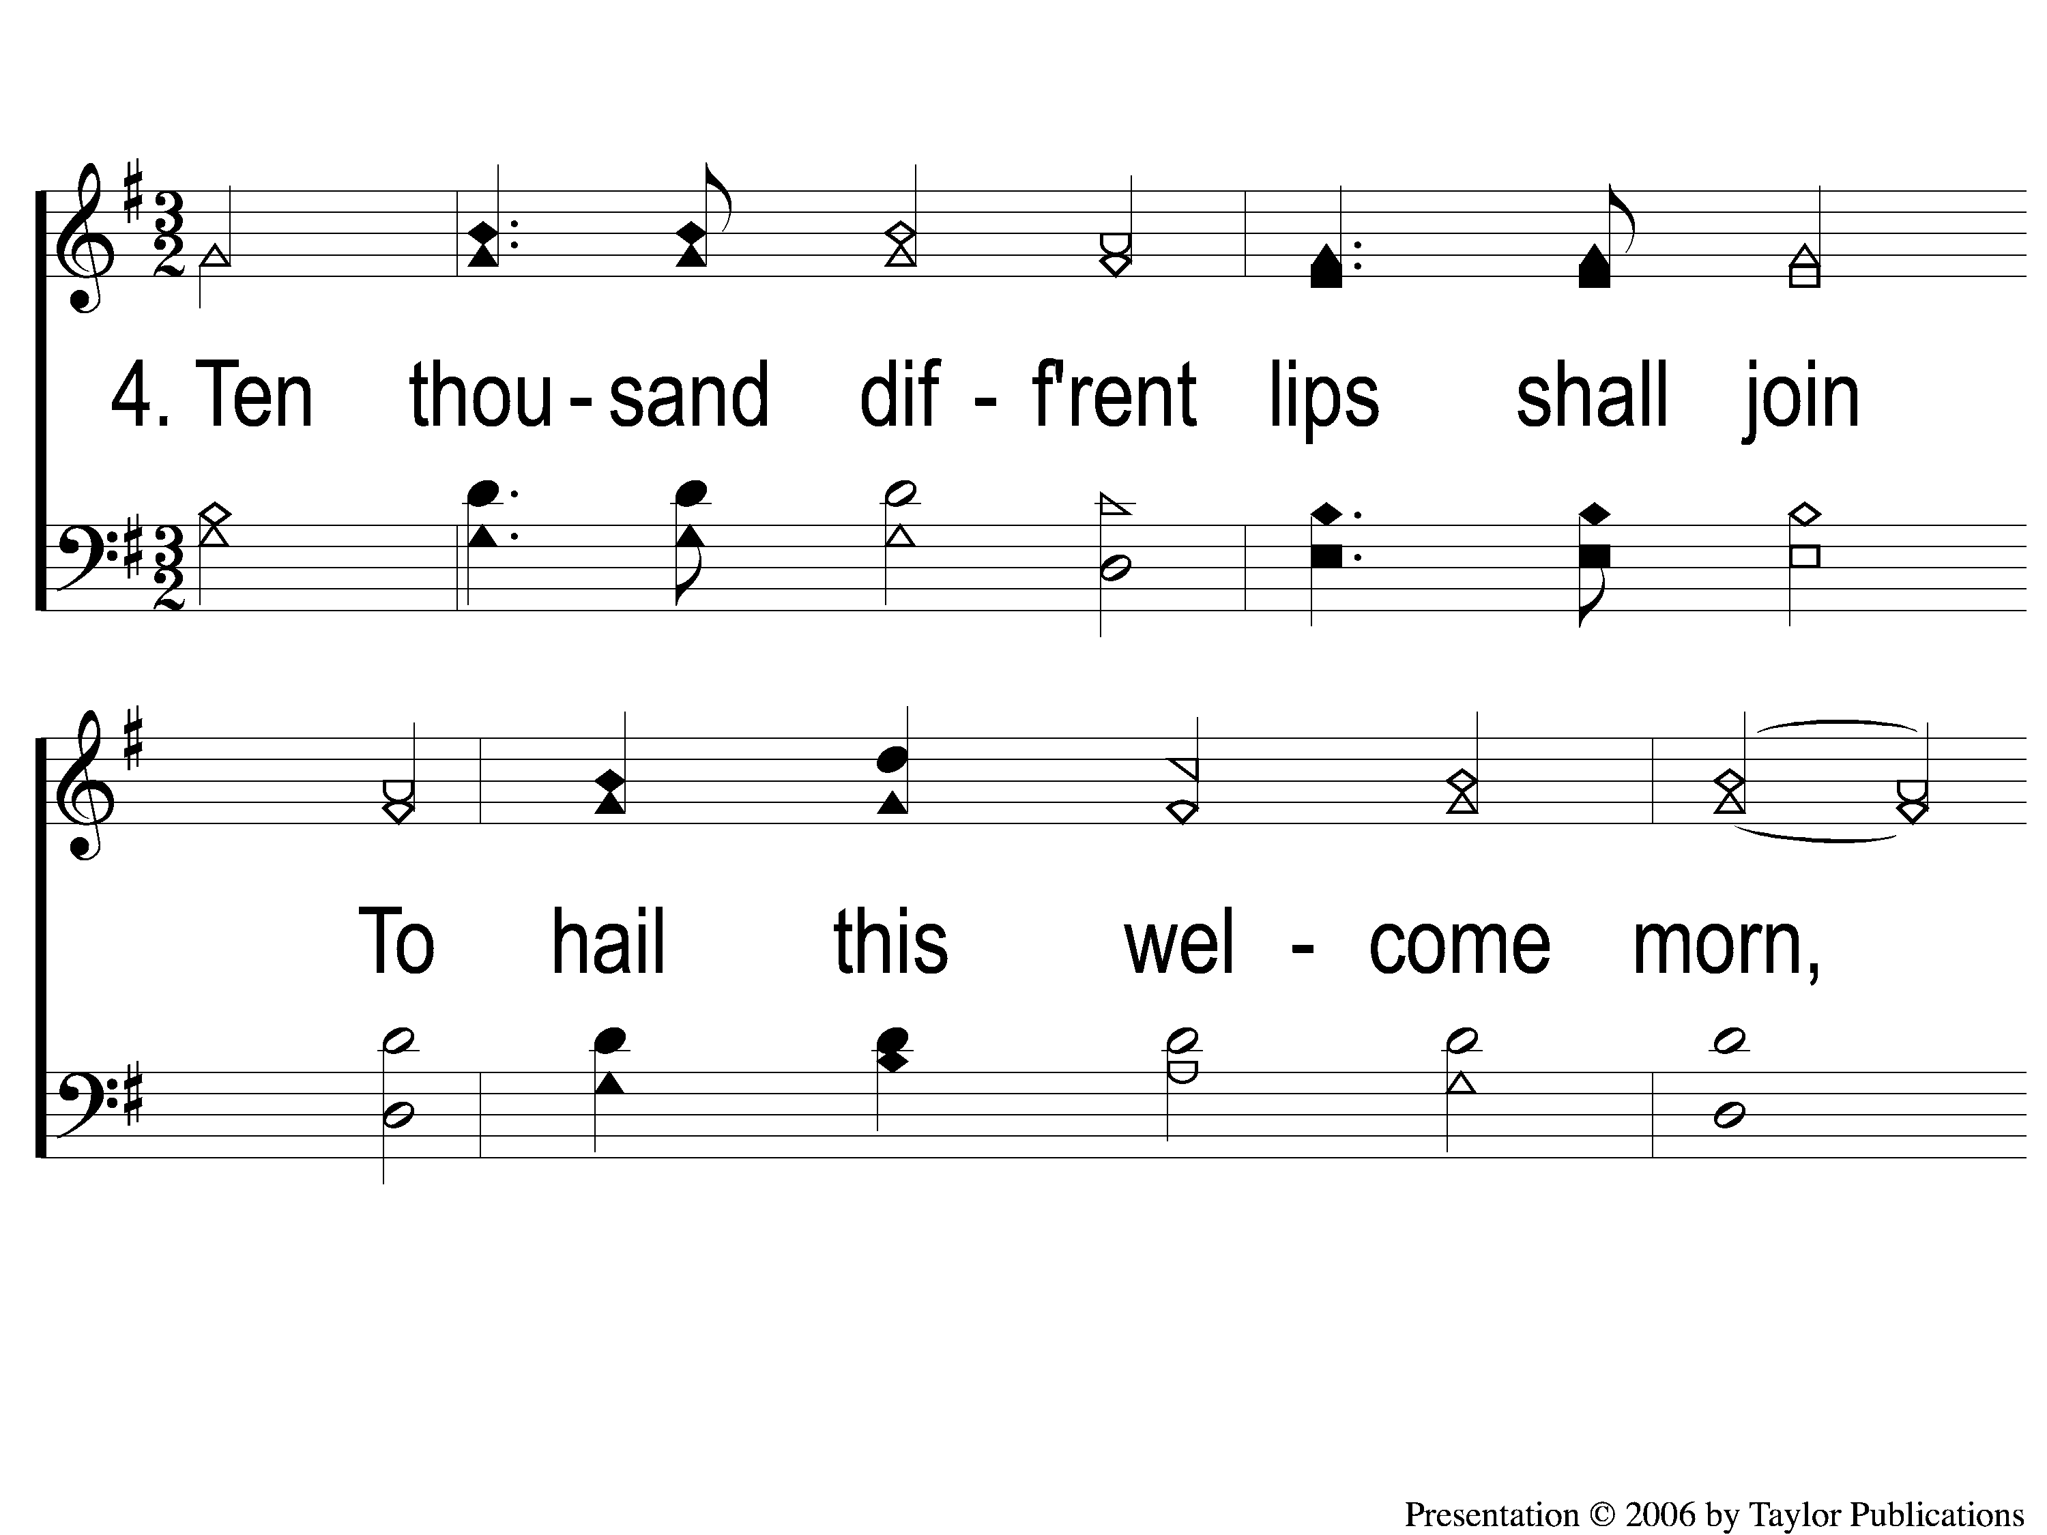
4-1 Again the Lord of Light and Light
Again the Lord of Light and Life
20

Slide 8
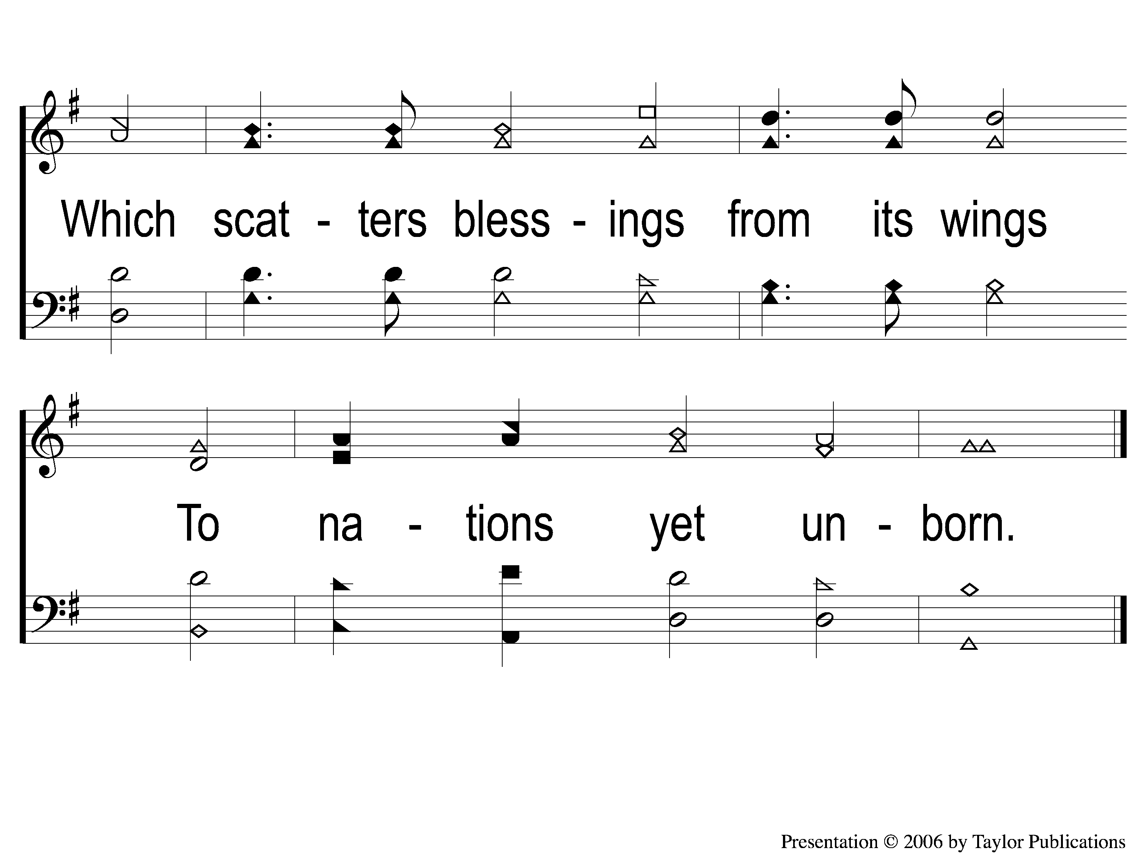
4-2 Again the Lord of Light and Light
Again the Lord of Light and Life
20

